Slide 1
C++ Programming
Chaper 7 Windows Programming and
MFC Introducing

Slide 2
Index
7.1 The Windows Programming Model
  7.1.1 Message Processing
  7.1.2 Handles
  7.1.3 Windows APIs
  7.1.4 A Windows Program
7.2 Introducing MFC
  7.2.1 The Visual C++ Components
  7.2.2 MFC Application Framework

Slide 3
7.1 The Windows Programming Model
Programs written for traditional operating environments use a procedural programming model in which programs execute from top to bottom in an orderly fashion.
The path taken from start to finish may vary with each invocation of the program depending on the input it receives or the conditions under which it is run, but the path remains fairly predictable.
In a C program, execution begins with the first line in the function named main and ends when main returns. In between, main might call other functions and these functions might call even more functions, but ultimately it is the program—not the operating system—that determines what gets called and when.

Slide 4
7.1 The Windows Programming Model
Windows programs operate differently. They use the event-driven programming model, in which applications respond to events by processing messages sent by the operating system.
An event could be a keystroke, a mouse click, or a command for a window to repaint itself, among other things.

Slide 5
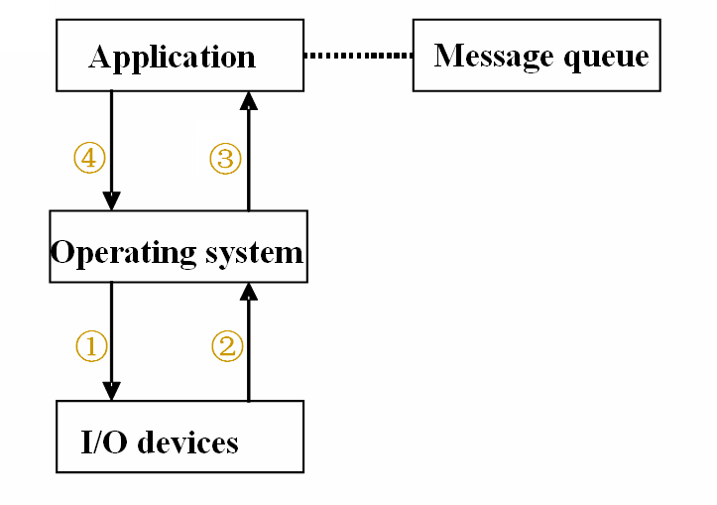
7.1 The Windows Programming Model

Slide 6
7.1.1 Message Processing
Where do messages come from, and what kinds of information do they convey? Windows defines hundreds of different message types. Most messages have names that begin with the letters "WM" and an underscore, as in WM_CREATE and WM_PAINT.
One way to characterize a Windows program is to think of it as a collection of message handlers. To a large extent, it is a program's unique way of responding to messages that gives it its personality.
  typedef struct tagMSG {
  HWND hwnd;
  UINT message;
  WPARAM wParam;
  LPARAM lParam;
  DWORD time;
  POINT pt;
  } MSG;

Slide 7
7.1.1 Message Processing
Common Windows Messages
Message | Sent When
WM_CHAR | A character is input from the keyboard.
WM_COMMAND | The user selects an item from a menu, or a control sends a notification to its parent.
WM_CREATE | A window is created.
WM_DESTROY | A window is destroyed.
WM_LBUTTONDOWN | The left mouse button is pressed.
WM_LBUTTONUP | The left mouse button is released.
WM_MOUSEMOVE | The mouse pointer is moved.
WM_PAINT | A window needs repainting.
WM_QUIT | The application is about to terminate.
WM_SIZE | A window is resized.

Slide 8
7.1.2 Handles
Handles are used quite frequently in Windows. Like HICON (a handle to an icon), HCURSOR (a handle to a mouse cursor), and HBRUSH (a handle to a graphics brush).
A handle is simply a number (usually 32 bits in size) that refers to an object. The handles in Windows are similar to file handles used in conventional C or MS-DOS programming.
A program almost always obtains a handle by calling a Windows function. The program uses the handle in other Windows functions to refer to the object.
The actual value of the handle is unimportant to your program, but the Windows module that gives your program the handle knows how to use it to reference the object.

Slide 9
7.1.2 Handles
Common Handles
Identifier | Meaning
HINSTANCE | Handle to an "instance"—the program itself
HWND | Handle to a window
HDC | Handle to a device context

Slide 10
7.1.3 Windows APIs
To a programmer, an operating system is defined by its API. An API encompasses all the function calls that an application program can make of an operating system, as well as definitions of associated data types and structures.
Early Windows programmers wrote applications in C for the Win16 application programming interface (API). Today, if you want to write 32-bit applications, you must use the new Win32 API, either directly or indirectly.

Slide 11
7.1.4 A Windows Program
The entry point for a Windows program is a function named WinMain, but most of the action takes place in a function known as the window procedure.The window procedure processes messages sent to the window.
WinMain creates that window and then enters a message loop, alternately retrieving messages and dispatching them to the window procedure. Messages wait in a message queue until they are retrieved.
A typical Windows application performs the bulk of its processing in response to the messages it receives, and in between messages, it does little except wait for the next message to arrive.

Slide 12
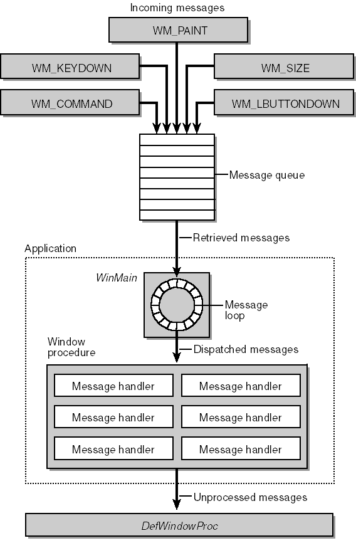

Slide 13
7.1.4 A Windows Program
Step 1:
WinMain begins by calling the API function RegisterClass to register a window class.
The window class defines important characteristics of a window such as its window procedure address, its default background color, and its icon. These and other properties are defined by filling in the fields of a WNDCLASS structure, which is subsequently passed to RegisterClass.
An application must specify a window class when it creates a window, and a class must be registered before it can be used. That's why RegisterClass is called at the outset of the program.

Slide 14
7.1.4 A Windows Program
Step 2:
Once the WNDCLASS is registered, WinMain calls the all-important CreateWindow function to create the application's window. The first parameter to CreateWindow is the name of the WNDCLASS from which the window will be created.
The window that CreateWindow creates is not initially visible on the screen because it was not created with the WS_VISIBLE style. (Had it been used, WS_VISIBLE would have been combined with WS_OVERLAPPEDWINDOW in the call to CreateWindow.) Therefore, WinMain follows CreateWindow with calls to ShowWindow and UpdateWindow, which make the window visible and ensure that its WM_PAINT handler is called immediately.

Slide 15
7.1.4 A Windows Program
Step 3:
Next comes the message loop. In order to retrieve and dispatch messages, WinMain executes a simple while loop that calls the GetMessage, TranslateMessage, and DispatchMessage API functions repeatedly.
GetMessage checks the message queue. If a message is available, it is removed from the queue and copied to msg; otherwise, GetMessage blocks on the empty message queue until a message is available. TranslateMessage converts a keyboard message denoting a character key to an easier-to-use WM_CHAR message.DispatchMessage dispatches the message to the window procedure.
The message loop executes until GetMessage returns 0, which happens only when a WM_QUIT message is retrieved from the message queue. When this occurs, WinMain ends and the program terminates.

Slide 16
7.1.4 A Windows Program
Step 4:
Messages dispatched with DispatchMessage generate calls to the window procedure WndProc.
The real action occurs in the window procedure. The window procedure determines what the window displays in its client area and how the window responds to user input.
Generally, Windows programmers use a switch and case construction to determine what message the window procedure is receiving and how to process it accordingly. All messages that a window procedure chooses not to process must be passed to a Windows function named DefWindowProc.

Slide 17
7.2.1 The Visual C++ Components
Microsoft Visual C++ is two complete Windows application development systems in one product. If you so choose, you can develop C-language Windows programs using only the Win32 API. Otherwise, you can develop C++ programs within the MFC library application framework.
A quick run-through of the Visual C++ components will help you get your bearings before you zero in on the application framework.

Slide 18
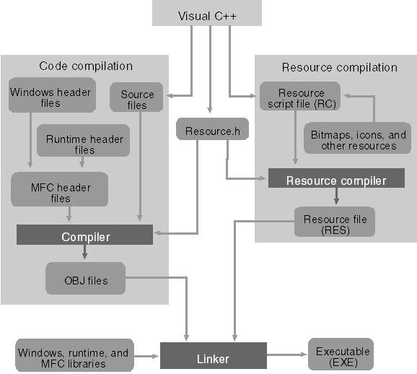
An overview of the Visual C++ application build process

Slide 19
7.2.1 The Visual C++ Components
The files that Visual C++ generates in the workspace.
File Extension | Description
APS | Supports ResourceView
BSC | Browser information file
CLW | Supports ClassWizard
DEP | Dependency file
DSP | Project file*
DSW | Workspace file*
MAK | External makefile
NCB | Supports ClassView
OPT | Holds workspace configuration
PLG | Builds log file

Slide 20
7.2.1 The Visual C++ Components
The Visual C++ components
The Resource Editors—Workspace ResourceView
The C/C++ Compiler
The Source Code Editor
The Resource Compiler
The Linker
The Debugger

Slide 21
7.2.1 The Visual C++ Components
AppWizard
AppWizard is a code generator that creates a working skeleton of a Windows application with features, class names, and source code filenames that you specify through dialog boxes.
AppWizard code is minimalist code; the functionality is inside the application framework base classes. AppWizard gets you started quickly with a new application.

Slide 22
7.2.1 The Visual C++ Components
ClassWizard
ClassWizard is a program (implemented as a DLL) that's accessible from Visual C++'s View menu.
ClassWizard takes the drudgery out of maintaining Visual C++ class code. Need a new class, a new virtual function, or a new message-handler function? ClassWizard writes the prototypes, the function bodies, and (if necessary) the code to link the Windows message to the function.
ClassWizard can update class code that you write, so you avoid the maintenance problems common to ordinary code generators.

Slide 23
7.2.2 MFC Application Framework
Why Use the Application Framework?
The MFC library is the C++ Microsoft Windows API.
Application framework applications use a standard structure.
Application framework applications are small and fast.
The Visual C++ tools reduce coding drudgery.
The MFC library application framework is feature rich.

Slide 24
7.2.2 MFC Application Framework
What's an Application Framework?
One reason that C++ is a popular language is that it can be "extended" with class libraries. A class library is a set of related C++ classes that can be used in an application.
An application framework is a superset of a class library. An ordinary library is an isolated set of classes designed to be incorporated into any program, but an application framework defines the structure of the program itself.

Slide 25
7.2.2 MFC Application Framework
The Document/View Architecture
The cornerstone of MFC's application framework is the document/view architecture, which defines a program structure that relies on document objects to hold an application's data and on view objects to render views of that data. MFC provides the infrastructure for documents and views in the classes CDocument and CView. CWinApp , CFrameWnd, and other classes work in conjunction with CDocument and CView to bind all the pieces together.
The reason documents and views are so important is that document/view applications derive the greatest benefit from the application framework.

Slide 26
7.2.2 MFC Application Framework
Not all of the functions that MFC offers are members of classes. MFC provides an API of sorts all its own in the form of global functions whose names begin with Afx.
Commonly Used AFX Functions
Function Name | Description
AfxAbort | Unconditionally terminates an application; usually called when an unrecoverable error occurs
AfxMessageBox | Displays a Windows message box
AfxGetApp | Returns a pointer to the application object
AfxGetAppName | Returns the name of the application
AfxGetMainWnd | Returns a pointer to the application's main window
AfxGetInstanceHandle | Returns a handle identifying the current application instance
AfxRegisterWndClass | Registers a custom WNDCLASS for an MFC application

